Slide 1

Lecture_10
李老师& 开课吧人工智能学院课程组
2020.03

Slide 2
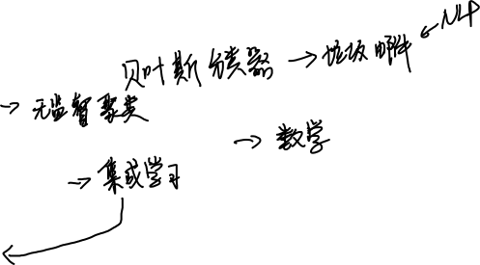
overview
Machine Learning Algorithms
Bayesian Learning
K-means
Support vector machine (SVM)
Ensemble Learning
Random Forest
XGBoost

Slide 3
Machine Learning I

Slide 4
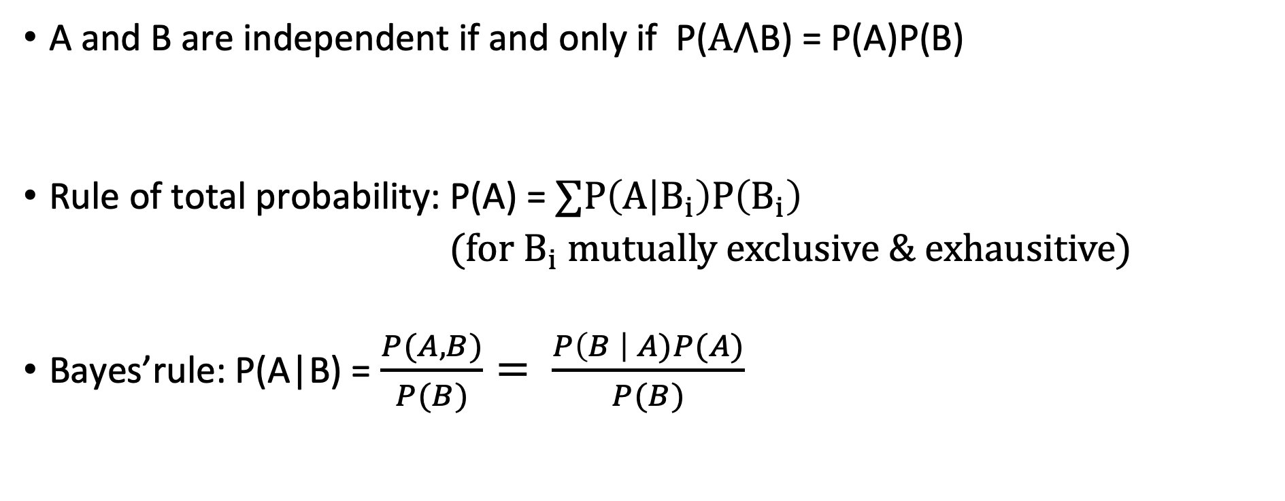
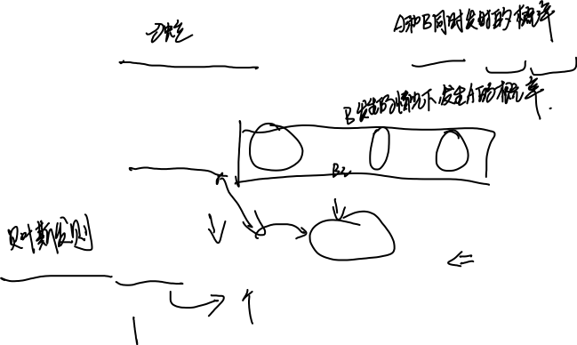
Recap of probability theory
A and B are independent if and only if P($A⋀$B) = P(A)P(B)
Rule of total probability: P(A) = $∑P\left(A | B_{i}\right)P\left(B_{i}\right)$
$(for B_{i} mutually exclusive \& exhausitive)$
Bayes’rule: P(A|B) = $\frac{P(A,B)}{P(B)}= \frac{P\left(B \right| A)P(A)}{P(B)}$

Slide 5
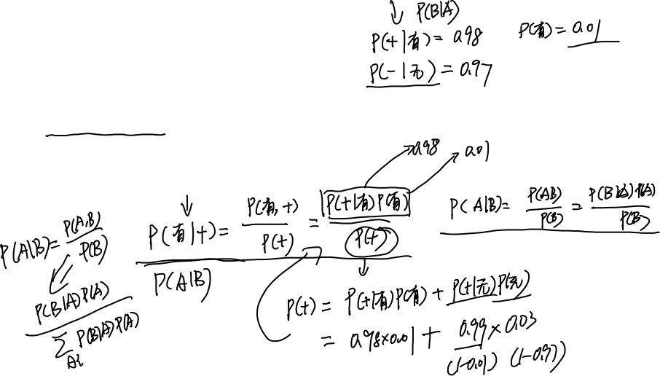
Example of Bayes’ rule
Assume some lab test for a disease has a 98% chance of being positive if disease present, and 97% chance of negative if disease absent.
Assume 1% of the population has this disease
A randomly chosen person tests positive. What is the probability that this person is ill?

Slide 6
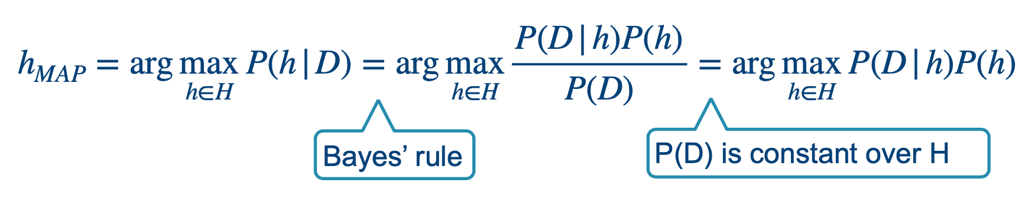
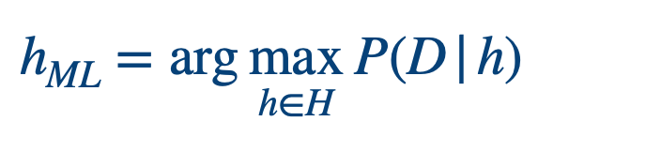
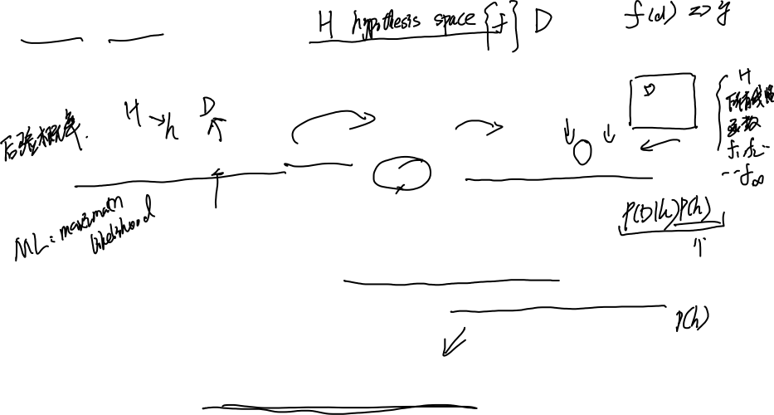

MAP/ML model
Concretely, in terms of probability: let D the observed data, H a hypothesis space, then
If P(h) is the same for all h in H. Then P(h) is constant, we can drop it from the formula. Finally we obtain maximum likelihood model.

Slide 7
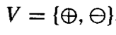
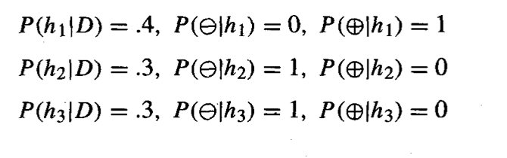
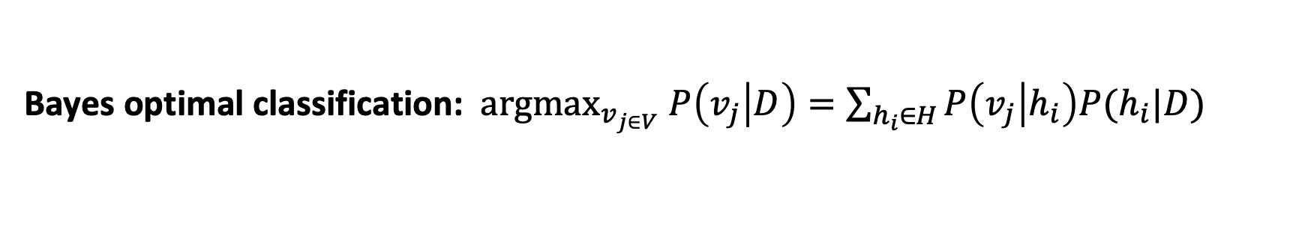
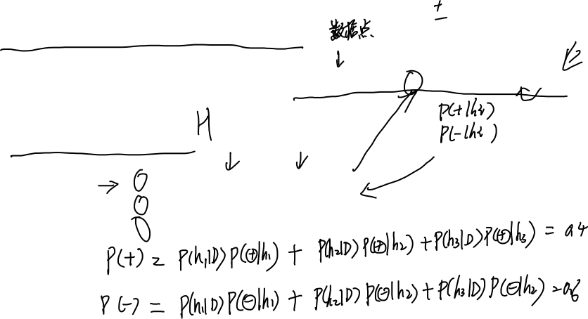
Bayes optimal classifier
Bayes optimal classification: ${argmax}_{v_{j∈V}} P\left(v_{j} | D\right)=\sum_{h_{i}∈H}{P\left(v_{j} | h_{i}\right)P(h_{i}|D)}$
An example:

Slide 8
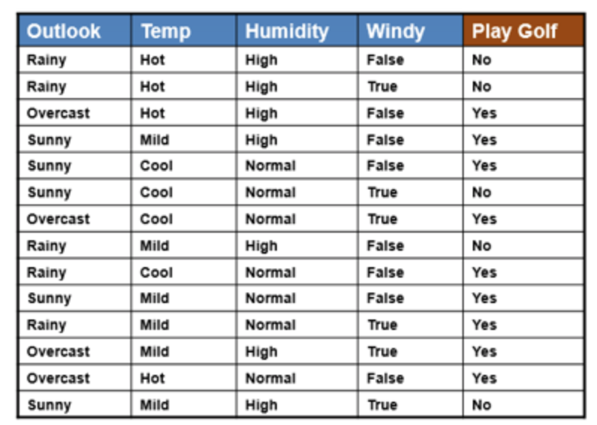

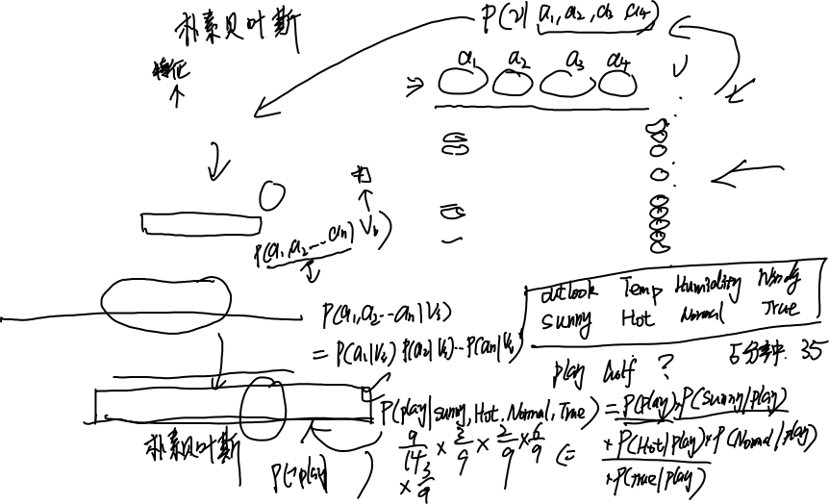
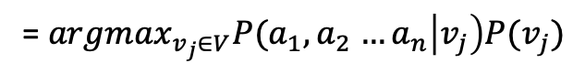

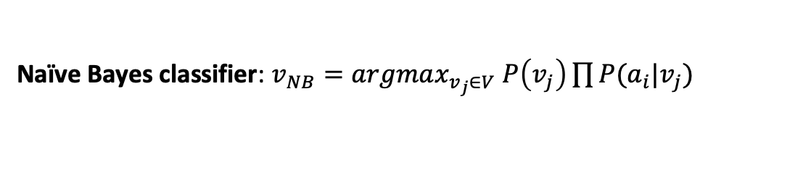
Naïve Bayes
An example :
$$v_{MAP}=argma{x_{v}}_{j∈V} P(v_{j}|a_{1},a_{2}…a_{n})$$
Bayes’rule
$$v_{MAP}=argmax_{v_{j}∈V}\frac{P\left(a_{1},a_{2}…a_{n} | v_{j}\right)P(v_{j})}{P(a_{1},a_{2}…a_{n})}$$
Drop denominator
= $argmax_{v_{j}∈V}P(a_{1},a_{2}$ $…a_{n}\left|v_{j}\right)P(v_{j})$
Independent assumption
Naïve Bayes classifier: $v_{NB}=argmax_{v_{j}∈V} P\left(v_{j}\right)\prod{P(a_{i}|v_{j})}$

Slide 9
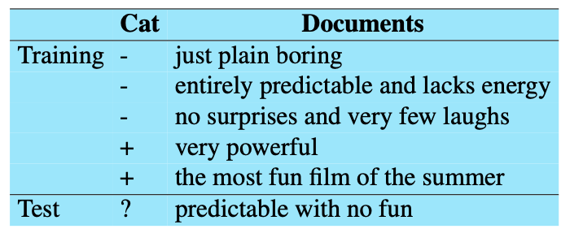
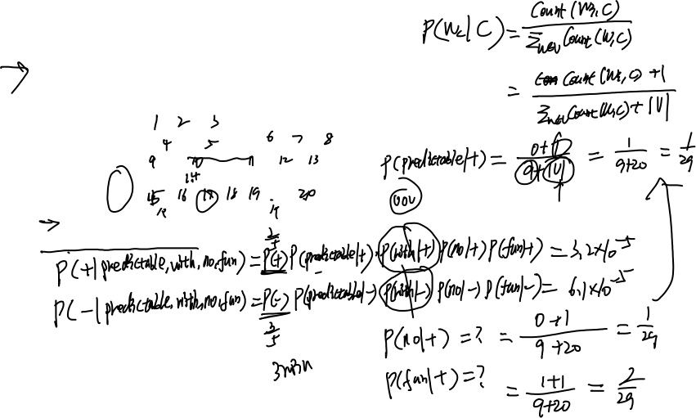
Naïve Bayes (an example)
! Use add-1 smoothing

Slide 10
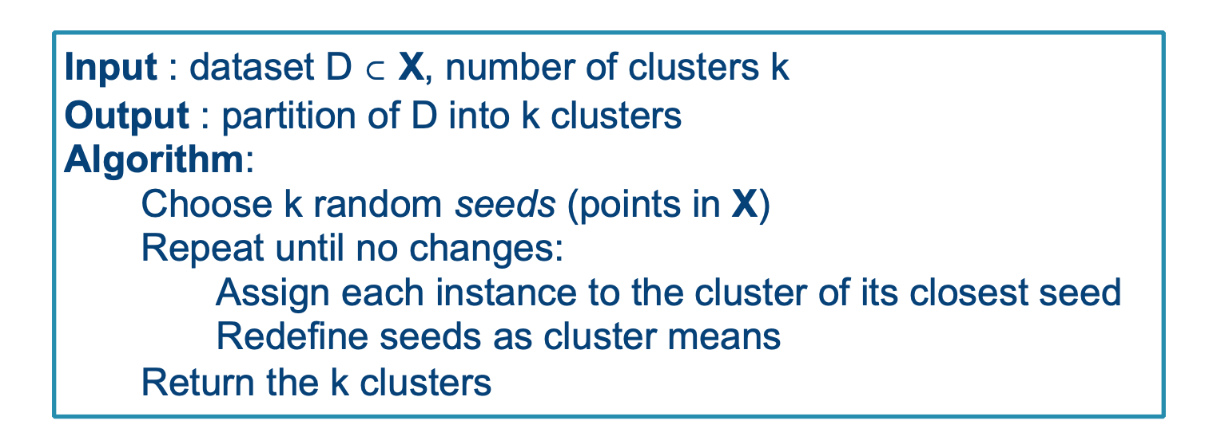
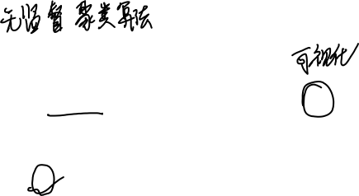
K-means

Slide 11
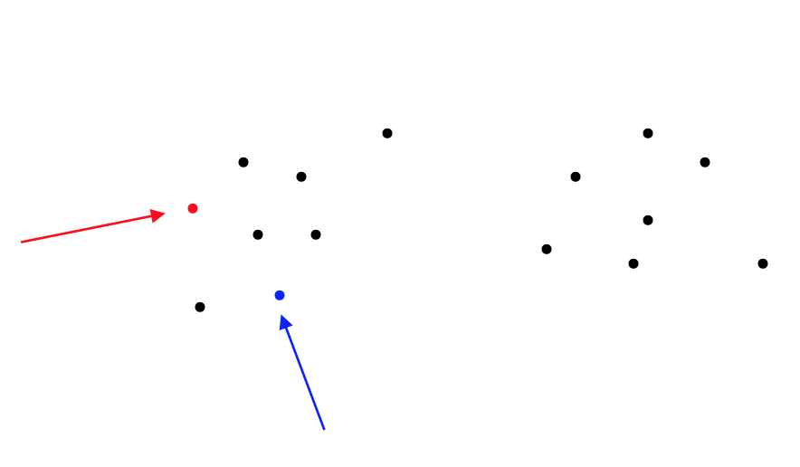
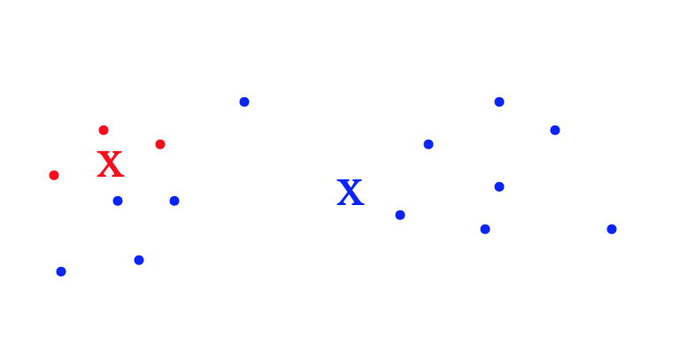
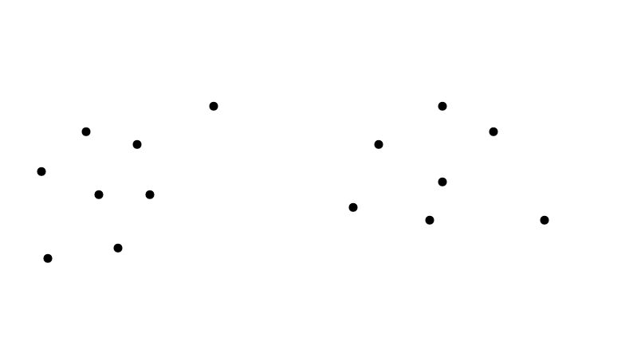
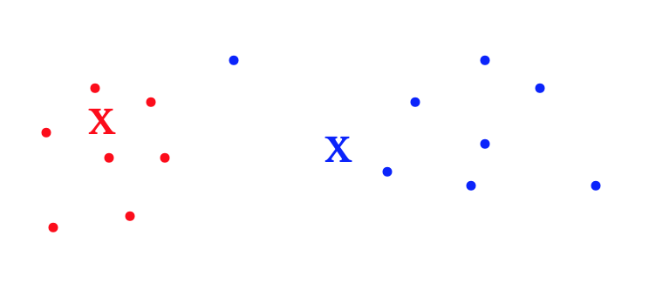
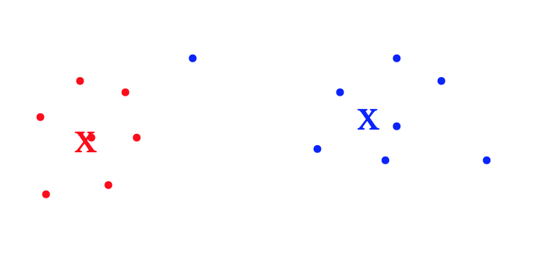
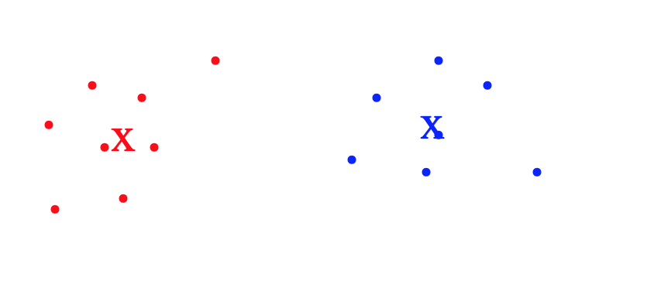
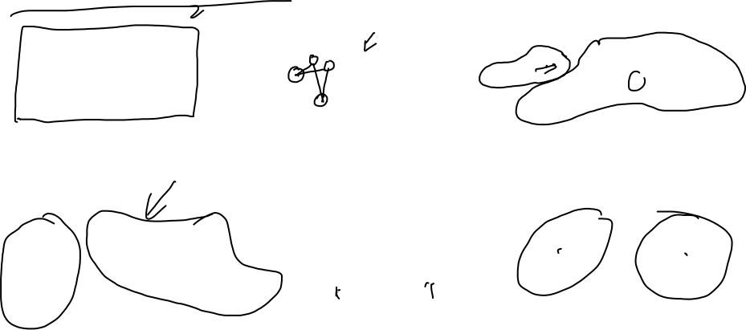
K-means illustration

Slide 12
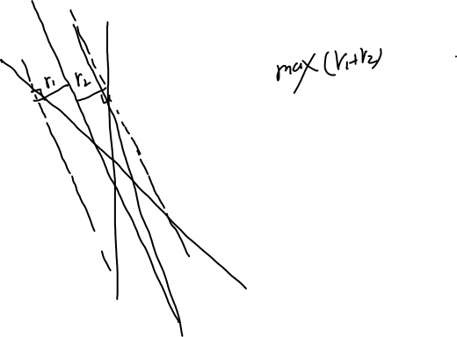
Support vector machine(General idea)

Slide 13
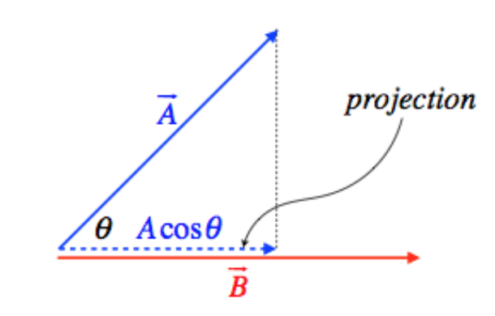
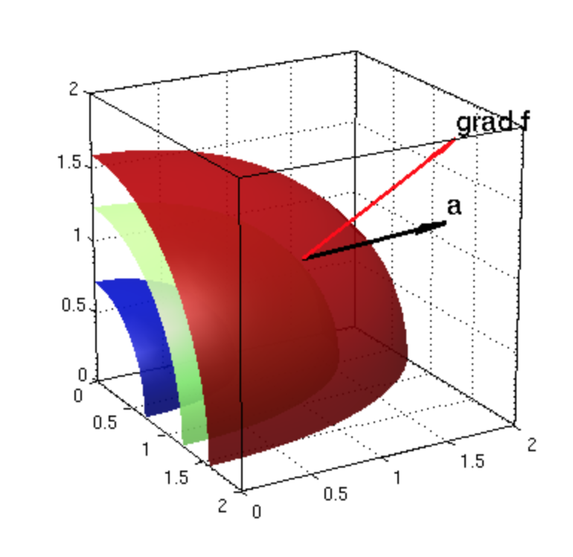
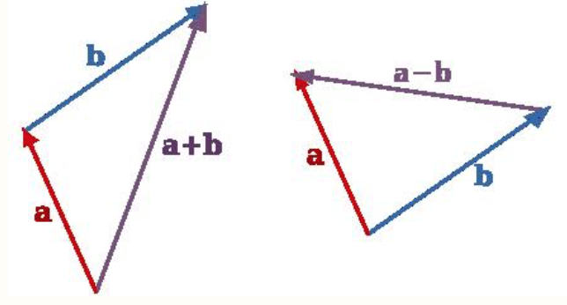
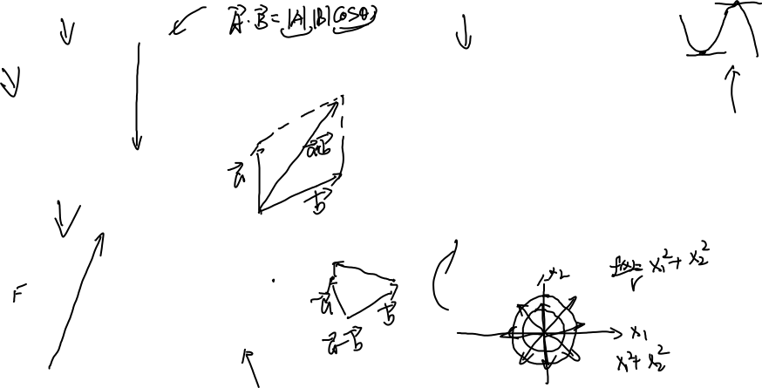
Support vector machine (Review some math)

Slide 14
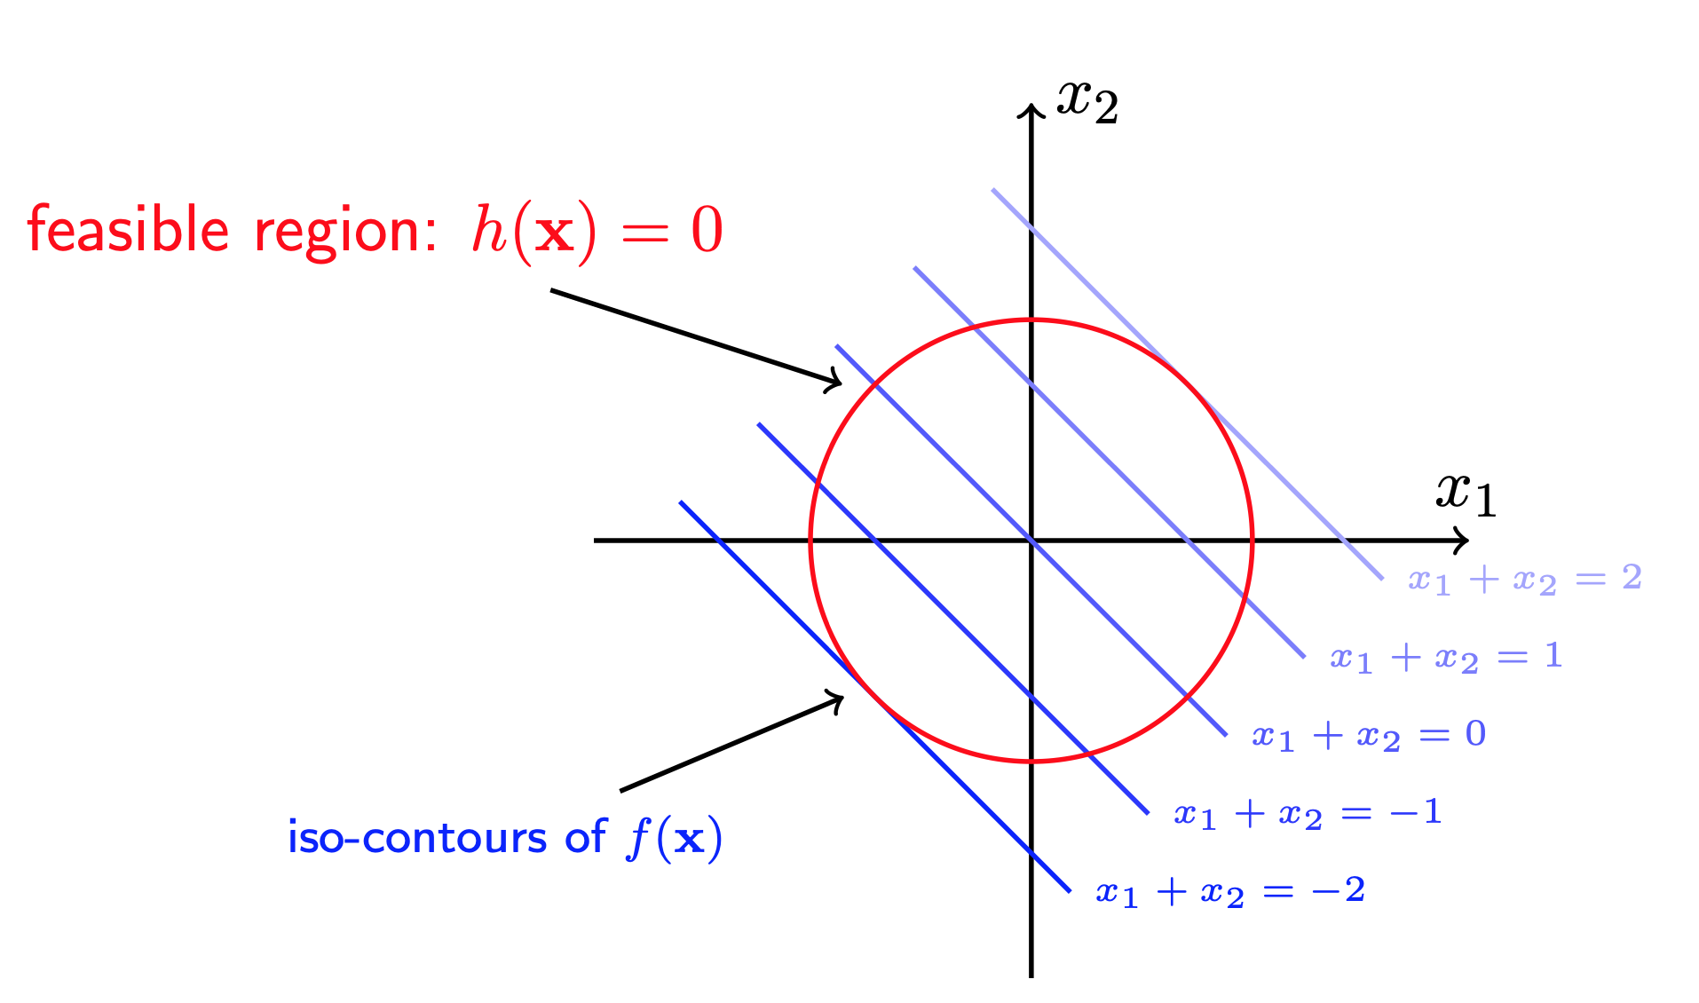

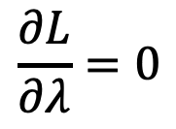
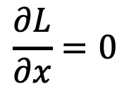

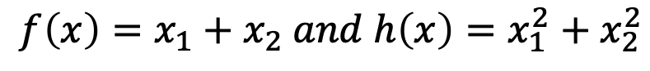
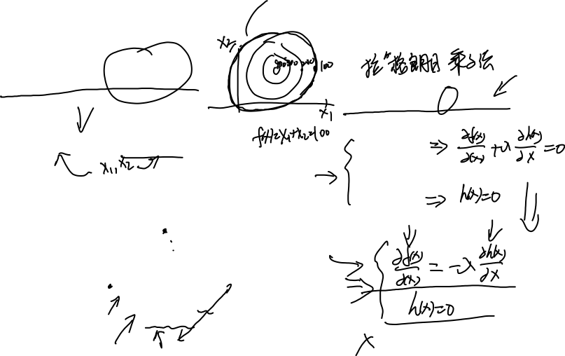
Constrained Optimization(equality constraints)
$$\min_{x∈R}{f\left(x\right) s.t. h\left(x\right)=0}$$
$$L=f\left(x\right)+λ h(x)$$
An example:
$$\frac{∂L}{∂x}=0$$
$$f\left(x\right)=x_{1}+x_{2} and h\left(x\right)=x_{1}^{2}+x_{2}^{2}$$
$$\frac{∂L}{∂λ}=0$$
f(x) increase

Slide 15
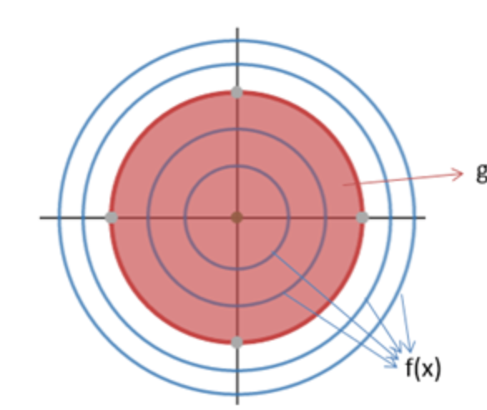
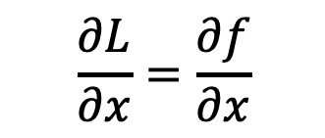
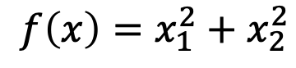

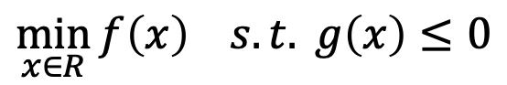
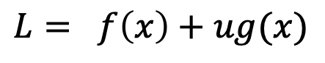
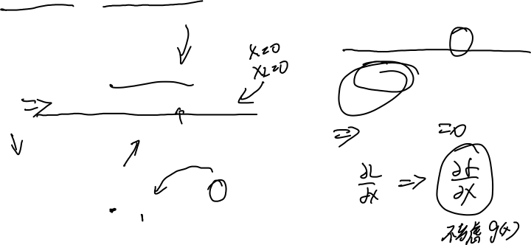
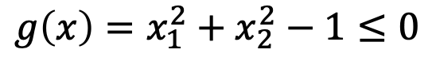
Constrained Optimization(Inequality constraints)
$$\min_{x∈R}{f\left(x\right) s.t. g\left(x\right)≤0}$$
Condition 1:
$$L= f\left(x\right)+ug(x)$$
$$f\left(x\right)=x_{1}^{2}+x_{2}^{2}$$
$$u=0$$
$$g\left(x\right)=x_{1}^{2}+x_{2}^{2}−1≤0$$
$$\frac{∂L}{∂x}=\frac{∂f}{∂x}$$

Slide 16
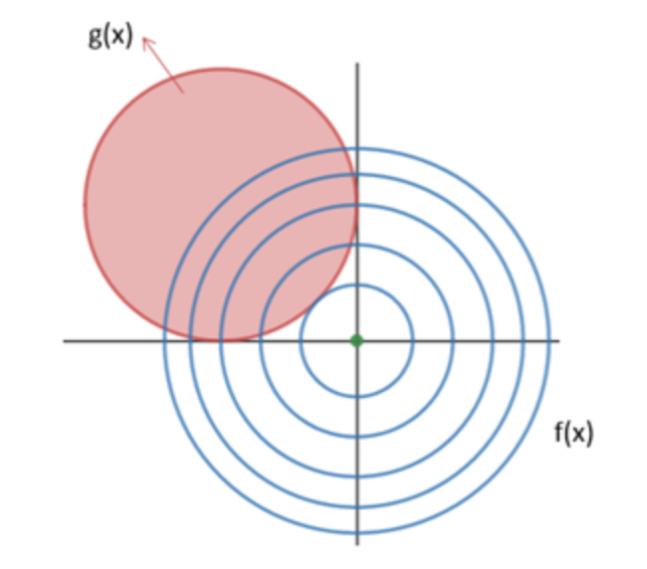


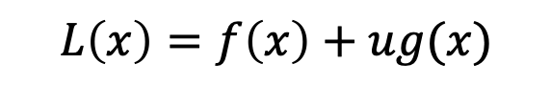
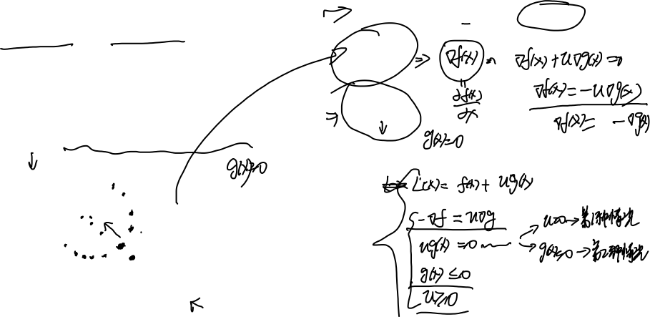

Constrained Optimization(Inequality constraints)
$$L\left(x\right)=f\left(x\right)+ug(x)$$
$$u≥0$$
$$\min_{x∈R}{f\left(x\right) s.t. g\left(x\right)≤0}$$
$$\frac{∂L}{∂x}=0$$
Condition 2:
$$\frac{∂L}{∂u}=0$$
$$f\left(x\right)=x_{1}^{2}+x_{2}^{2}$$
$$g\left(x\right)={\left(x_{1}+1\right)}^{2}+{\left(x_{2}−1\right)}^{2}−1≤0$$
Combine both conditions:
f(x) increase
The optimal solution is at the boundary.
g(x) increase

Slide 17
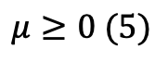
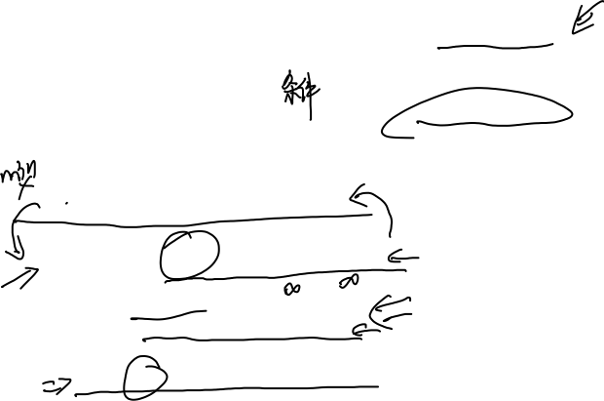
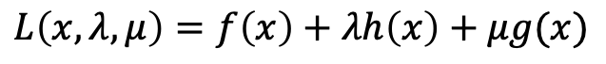
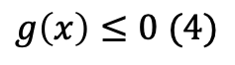





Constrained Optimization(KKT condition)
$$\min_{x∈R}{f\left(x\right) s.t. g\left(x\right)≤0 h\left(x\right)=0}$$
$∇_{x} L=0$ (1)
$$μg\left(x\right)=0 (2)$$
KKT
Lagrange multiplier
$$h\left(x\right)=0 (3)$$
$$g\left(x\right)≤0 (4)$$
$$μ≥0 (5)$$
$$L\left(x,λ,μ\right)=f\left(x\right)+λh\left(x\right)+μg(x)$$
$$L\left(x,λ,u\right)=\min_{x}{\max_{u,λ}{f\left(x\right)+λh\left(x\right)+ug(x)}}$$
$$L\left(x,u,λ\right)=\left\{\begin{aligned}f\left(x\right) x∈feasible region \\ ∞ other\end{aligned}\right.$$
$$\min{\max{f\left(x\right)≥\max{\min{f(x)}}}}$$

Slide 18








An example (KKT)
$$\min{x_{1}^{2}+x_{2}^{2}} s.t x_{1}+x_{2}=1 , x_{2}≤α$$
$$L=x_{1}^{2}+x_{2}^{2}+λ\left(1−x_{1}−x_{2}\right)+u(x_{2}−α)$$
KKT
$$\frac{∂L}{∂x_{1}}=0 \frac{∂L}{x_{2}}=0 x_{1}+x_{2}=1$$
$x_{2}−α≤0 u≥0 u\left(x_{2}−α\right)=0$
$∇_{x} L=0$ (1)
$$μg\left(x\right)=0 (2)$$
$$h\left(x\right)=0 (3)$$
$$g\left(x\right)≤0 (4)$$
$$μ≥0 (5)$$

Slide 19

SVM (Derivation)
SVM (Derivation)
+
+
-
-

Slide 20












SVM (Derivation)
$$\min_{w,b}{J\left(W\right)=\min_{W,b}{\frac{{\left|\left|W\right|\right|}^{2}}{2}} }$$
$$s.t {1 −y}_{i}\left(x_{i}w_{i}+b\right)≤0$$
$$\min_{w,b}{L\left(w,b,α\right)= \sum_{i=1}^{n}{α_{i} −\frac{1}{2}\sum_{i=1}^{n}{\sum_{j=1}^{n}{α_{i}α_{j}y_{i}y_{j}x_{i}x_{j}}}}}$$
$$\min_{α}{\frac{1}{2}\sum_{i=1}^{n}{\sum_{j=1}^{n}{α_{i}α_{j}y_{i}y_{j}x_{i}x_{j}}} −\sum_{i=1}^{n}{α_{i}}}$$
$$L\left(w,b,α\right)=\frac{1}{2}{\left|\left|w\right|\right|}^{2} −\sum_{i=1}^{n}{α_{i}[y_{i}\left(x_{i}w+b\right)−1]}$$
$$s.t \sum_{i=1}^{n}{α_{i}y_{i}=0 α_{i}≥0}$$
SMO
$$\min_{w,b}{\max_{α}{L(w,b,α) }}$$
$$W= \sum_{i=1}^{n}{α_{i}y_{i}x_{i}}$$
$$\frac{∂L}{∂w}=0$$
$$b=y_{j} − \sum_{i=1}^{n}{α_{i}y_{i}x_{j}x_{i}}$$
$$\frac{∂L}{∂b}=0$$

Slide 21








$$\sum_{i=1}^{n}{α_{i}y_{I}xx_{i}+b=0}$$
$$f\left(x\right)=sign(\sum_{i=1}^{n}{α_{i}y_{i}xx_{i}+b)}$$
Support vectors
$α>0$
$$α=0$$

Slide 22



An example
$$x_{2}$$
1
2
(3,3)
(4,3)
3
(1,1)
$$x_{1}$$

Slide 23



Kernal trick

Slide 24

Summary of SVM
Advantages:
Convex function = > global optimal
Kernal tricks = > non-linear separable data
Avoid the curses of dimensionality
Explainable
Disadvantages:
1.Computational complexity
2. Two-class classifier

Slide 25

Ensemble Learning

Slide 26


Ensemble learning
Learner 1
Learner 2
Training data
Learner
…
Learner 3

Slide 27

Bagging
Training data
K training set (generated using bootstraping)
Learner 1
Learner 2
…
Learner n
Prediction

Slide 28




Boosting
Training data
weight (1)
weight (2)
…
weight (k)
Update
Update
Update
Learner 1
Learner 2
…
Learner n
$$w_{2}$$
$$w_{1}$$
$$w_{3}$$
Prediction

Slide 29



Random forest

Slide 30


Random forest

Slide 31


XGBOOST

Slide 32


XGBoost
$$Obj=\sum_{i=1}^{n}{l\left(y_{i},{\hat{y}}_{i}\right)+ \sum_{k=1}^{K}{Ω(f_{k})} }$$
Objective function
Loss
Regularization term

Slide 33











$$Ω\left(f_{t}\right)=γT+\frac{1}{2}λ\sum_{j=1}^{T}{w_{j}^{2}}$$
$$Ω=γ3+ \frac{1}{2}λ(2^{2}+{0.1}^{2}+{\left(−1\right)}^{2})$$
Leaf 1
Leaf 2
Leaf 3
$$w_{1}=+2$$
$$w_{2}=0.1$$
$$w_{3}=−1$$

Slide 34


Slide 35


Slide 36


An example

Slide 38



$$Gain= \frac{1}{2}\left[\frac{G_{L}^{2}}{H_{L}+λ}+ \frac{G_{R}^{2}}{H_{R}+λ} − \frac{{\left(G_{L}+G_{R}\right)}^{2}}{H_{L}+H_{R}+λ}\right]−λ$$

Slide 39

Thanks for your attending!

